Slide 1

Data Science Salary Trends for US Workers – 1Q2023
Rutgers Data Visualization Bootcamp – Group 3
June 2023

Slide 2



Agenda
Introduction
Data Cleaning
Data Analysis
Modeling
Predictions
Lessons Learned
June 11, 2023
Data-Related Jobs Salary Predictor app
2

Slide 3




Introduction
The aim of this project was to create a model and app to predict salary of data science jobs in the US based on job title,
Data source:
Hypothesis or questions this analysis can visualize or questions the model can answer
June 11, 2023
Data-Related Jobs Salary Predictor app
3

Slide 4

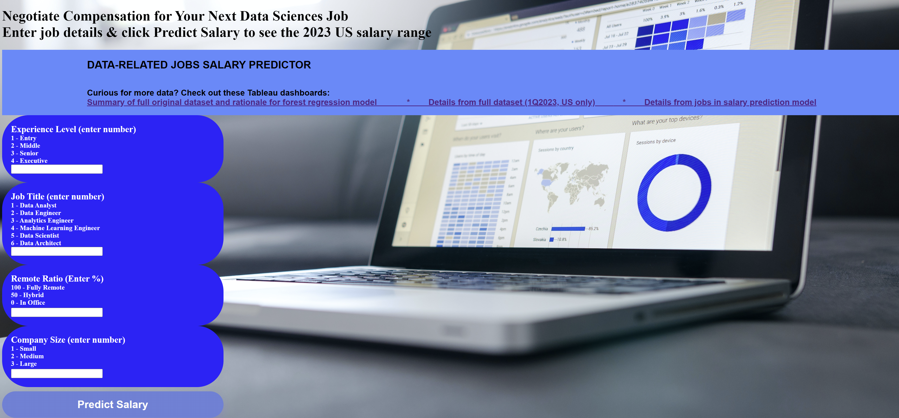
June 11, 2023
Data-Related Jobs Salary Predictor app
4

Slide 5







Tools Used
 | Pandas | Path | Tableau | Scikit-learn | Flask | pickle | HTML | CSS
Cleaning | X | X | X
Analysis | X | X | X
Visualization |  |  | X |  |  |  | X
Modeling | X | X |  | X
Website design |  |  |  |  | X | X | X | X
Predictions |  |  |  | X | X | X | X
June 11, 2023
Data-Related Jobs Salary Predictor app
5

Slide 6





Team
Calogera McCormick
Sana Ayubzai
Minta Burke
Aaron Lilleoien
Tawn Scotton
Select Dataset
Data Cleaning
Data Analysis
Data Modeling
Data Predictions
Project Manager
Data Scientist
Data Engineer
Data Architect
Data Analyst
June 11, 2023
Data-Related Jobs Salary Predictor app
6

Slide 7

Data Cleaning
Used Tableau to visualize full dataset. Identified roles with highest frequency and features (eg, ex-US countries, contractor job type) with low frequency.
Dropped null values and null values.
Identified columns that did not add value & marked for deletion.
Used Python to refine dataset.
Grouped data - combined all job titles into 7 grouped titles (ie, Data Analyst, Data Architect, Data Engineer, Data Manager, Data Scientist, Developer, Other)
Binned data – 9 bins of salary data from from <50K to >400K USD
Codified features that were categorical data (eg, experience level updated to 1, 2, 3, 4).
June 11, 2023
Data-Related Jobs Salary Predictor app
7

Slide 8
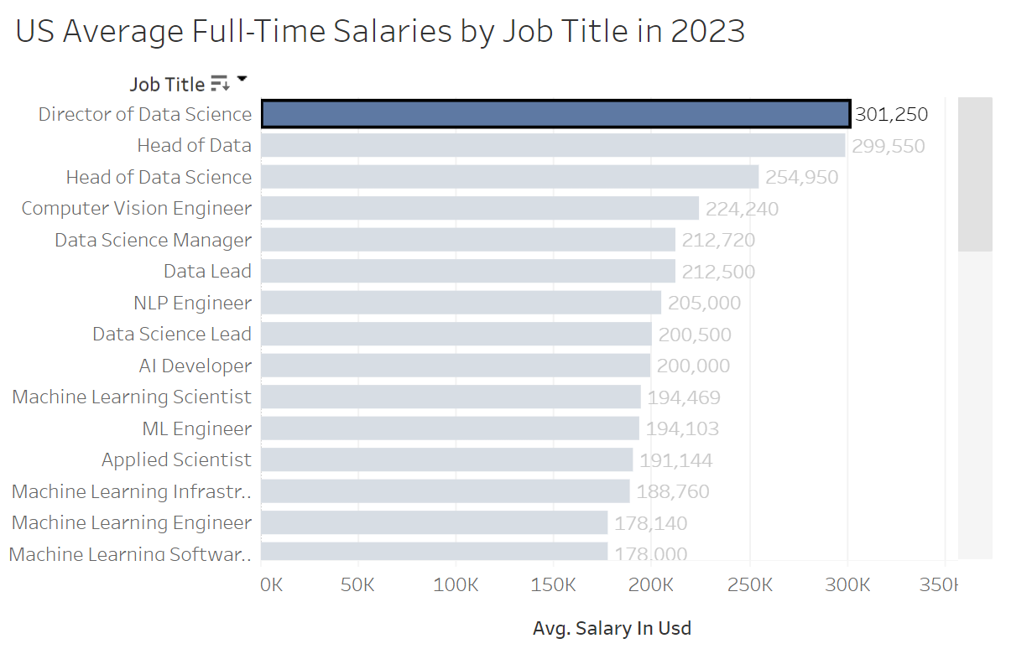
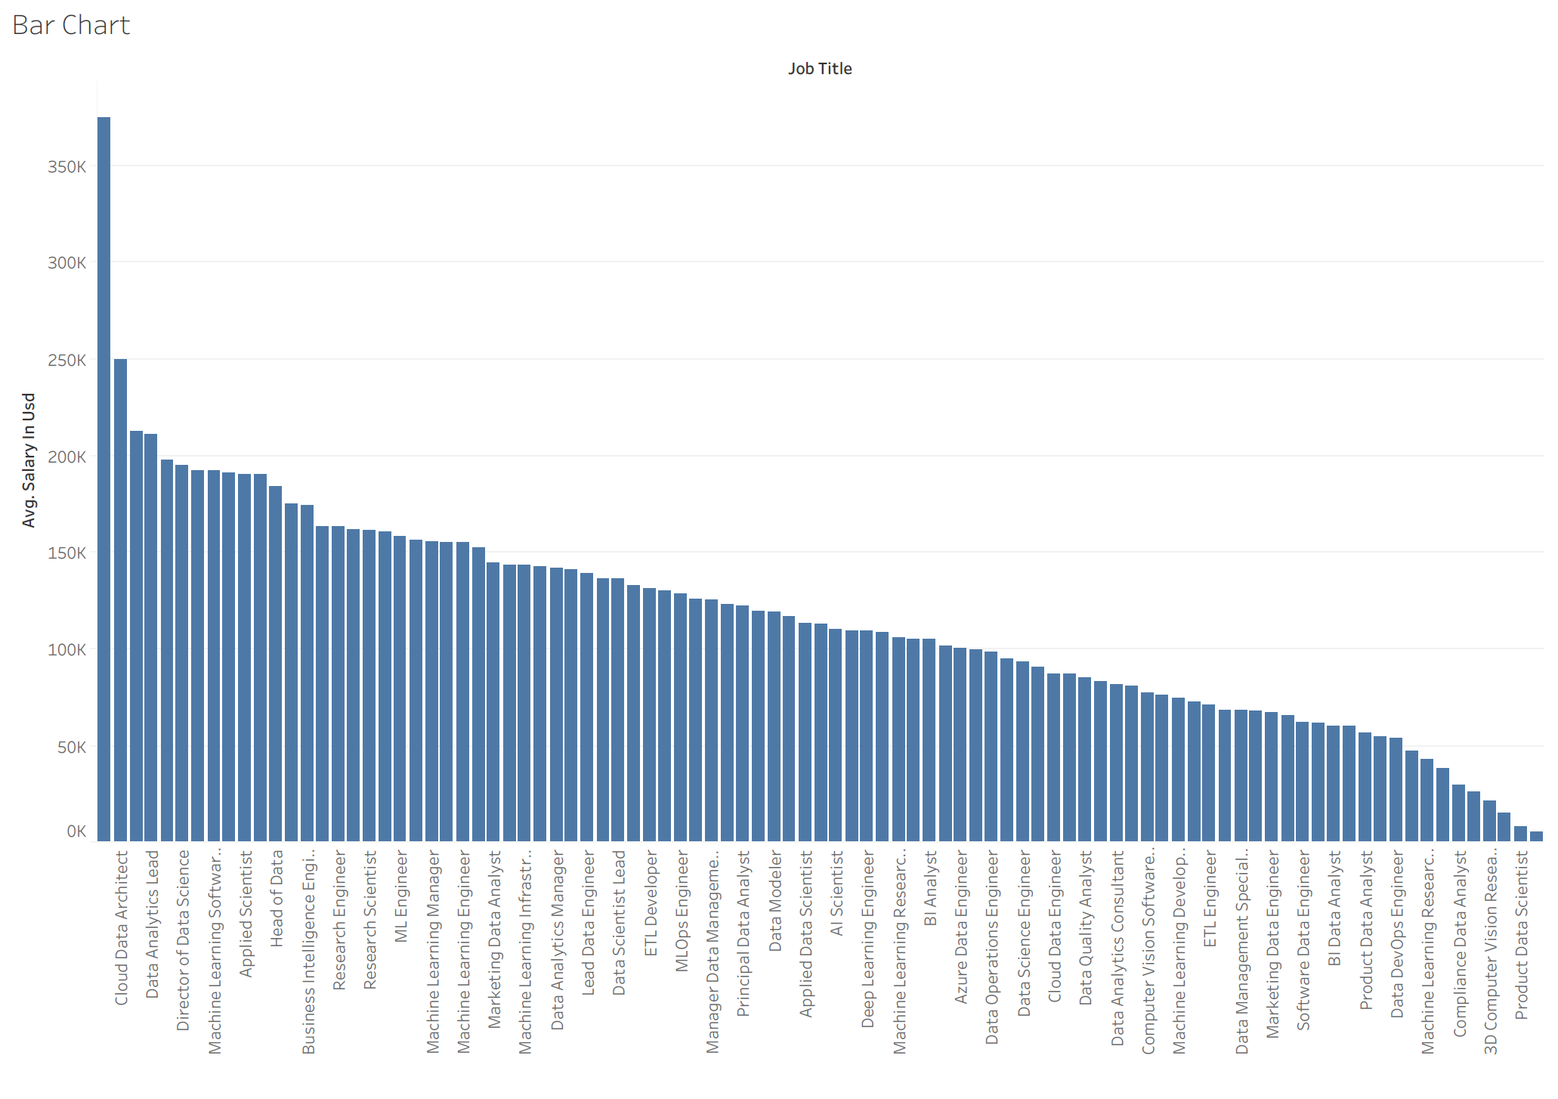
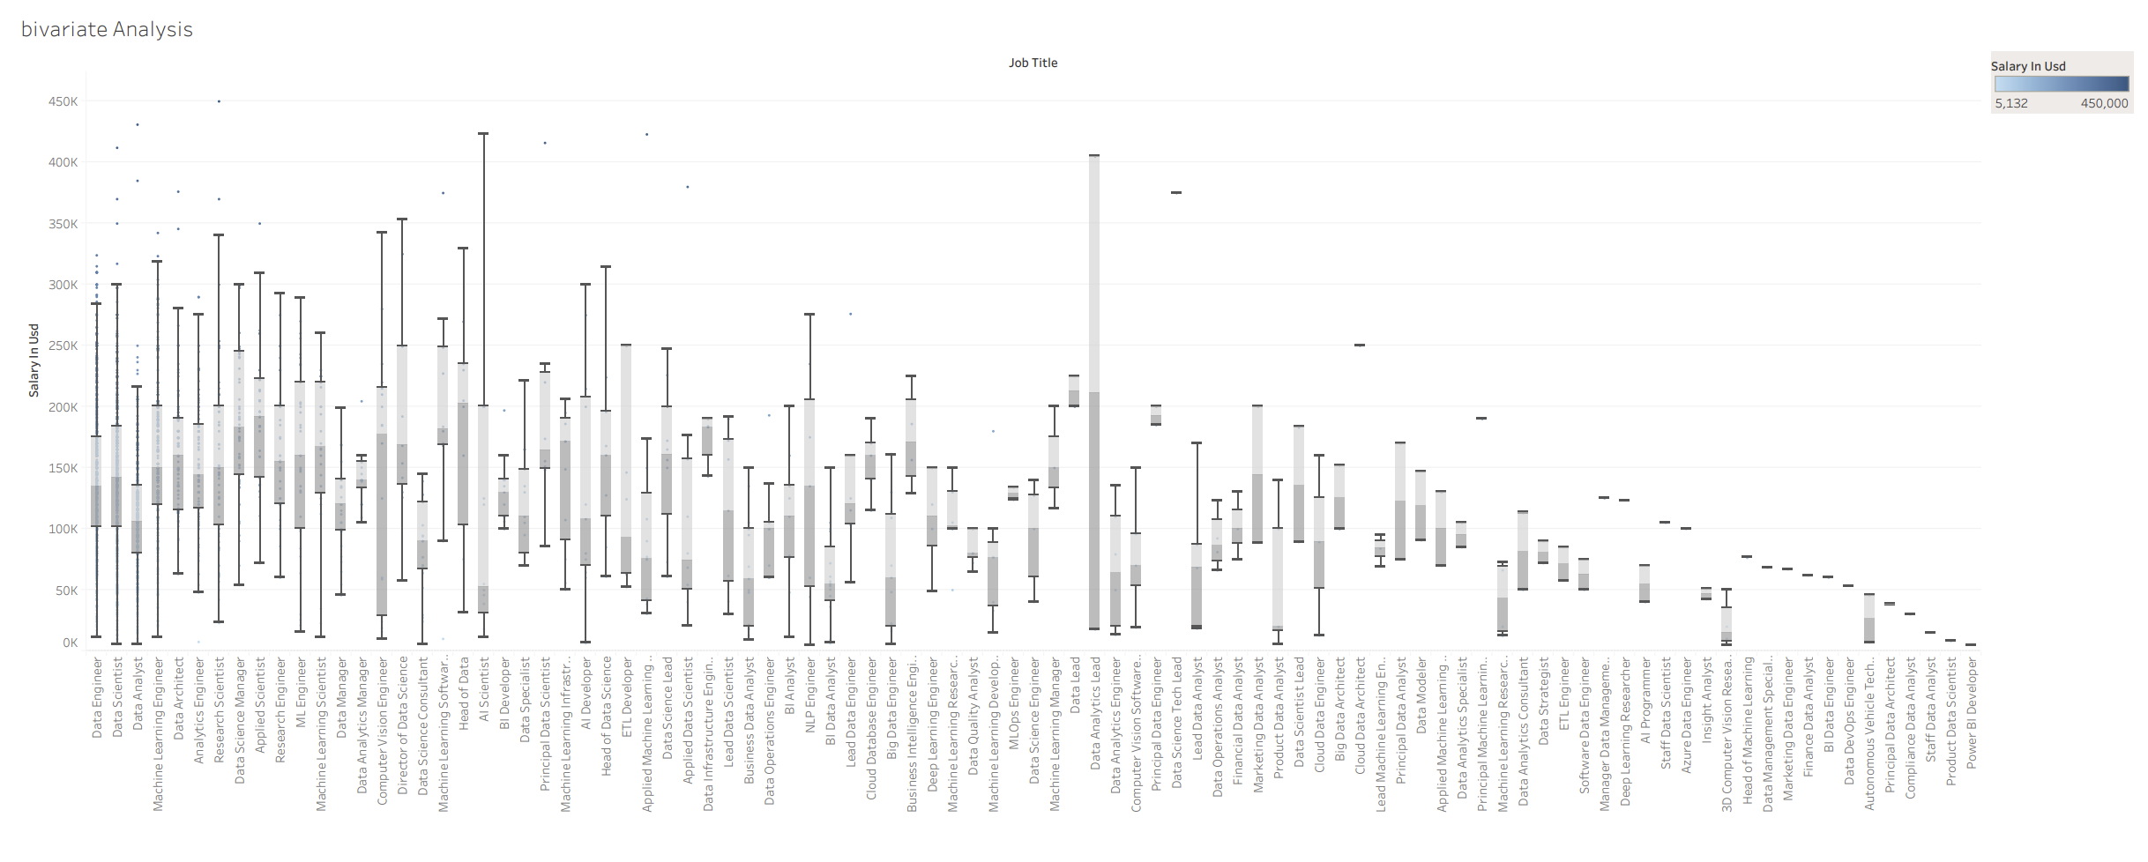
Data Cleaning (Original csv Data)
Average salary by job title
Average Salary by job title
Bivariate Analysis
June 11, 2023
Data-Related Jobs Salary Predictor app
8

Slide 9
June 11, 2023
Data-Related Jobs Salary Predictor app
9

Slide 10
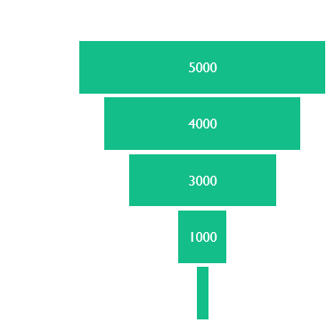
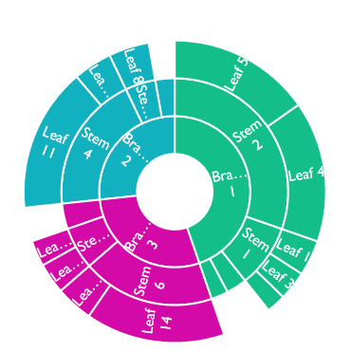
Show graphs like Tableau dashboard
June 11, 2023
Data-Related Jobs Salary Predictor app
10

Slide 11
Content
Subtitle
Subtitle
Add text, images, art, and videos.
Add transitions, animations, and motion.
Save to OneDrive, to get to your presentations from your computer, tablet, or phone.
Open the Design Ideas pane for instant slide makeovers.
When we have design ideas, we’ll show them to you right there.
June 11, 2023
Data-Related Jobs Salary Predictor app
11

Slide 12
Data Analysis
June 11, 2023
Data-Related Jobs Salary Predictor app
12

Slide 13
Content 2
Subtitle
subtitle
subtitle
Add text, images, art, and videos.
Add transitions, animations, and motion.
Save to OneDrive, to get to your presentations from your computer, tablet, or phone.
Open the Design Ideas pane for instant slide makeovers.
When we have design ideas, we’ll show them to you right there.
Add text, images, art, and videos.
Add transitions, animations, and motion.
Save to OneDrive, to get to your presentations from your computer, tablet, or phone.
Open the Design Ideas pane for instant slide makeovers.
When we have design ideas, we’ll show them to you right there.
Add text, images, art, and videos.
Add transitions, animations, and motion.
Save to OneDrive, to get to your presentations from your computer, tablet, or phone.
Open the Design Ideas pane for instant slide makeovers.
When we have design ideas, we’ll show them to you right there.
June 11, 2023
Data-Related Jobs Salary Predictor app
13

Slide 14
Data Modeling
Gathered and prepared the data: Imported the refined csv from the data cleaning.
Split the data into training and test data sets.
Identified the features (job category, experience level, remote ratio, company size) and target variable (ie, salary in USD).
Trained and tested a forest regression model.
Evaluated model and finetuned the model.
June 11, 2023
Data-Related Jobs Salary Predictor app
14

Slide 15
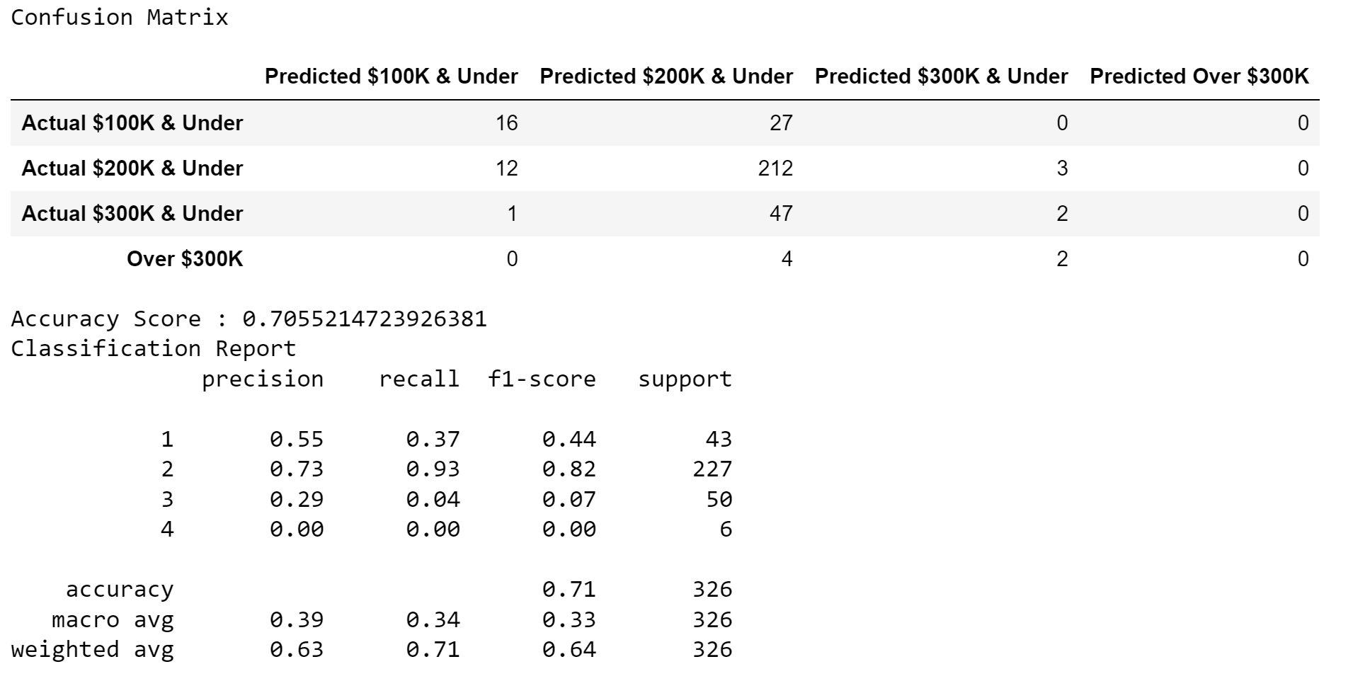
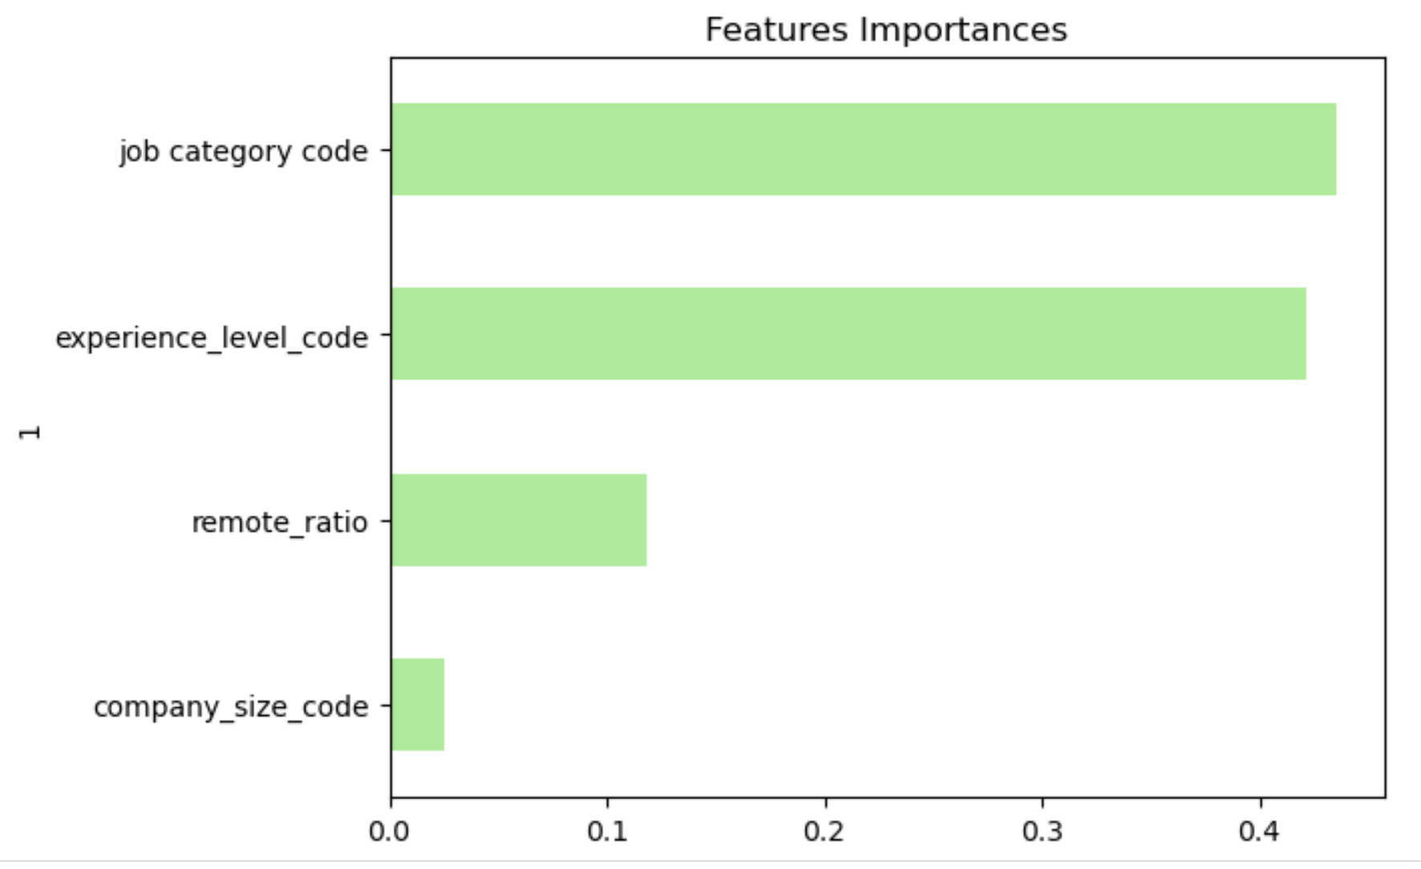
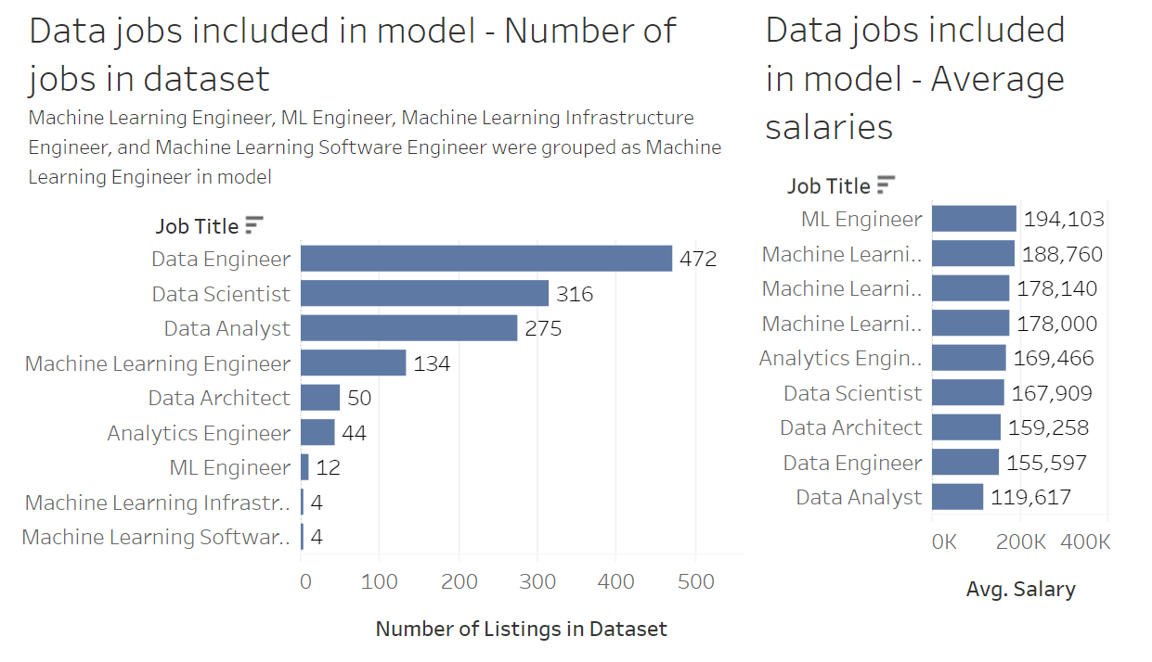
Implementing the Random Forest Model
Model accuracy
Feature importance in MODEL
Average Salary per job title - model
June 11, 2023
Data-Related Jobs Salary Predictor app
15

Slide 16
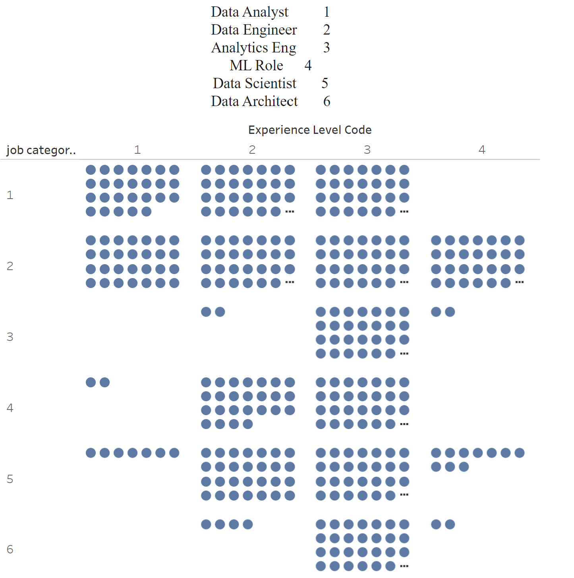
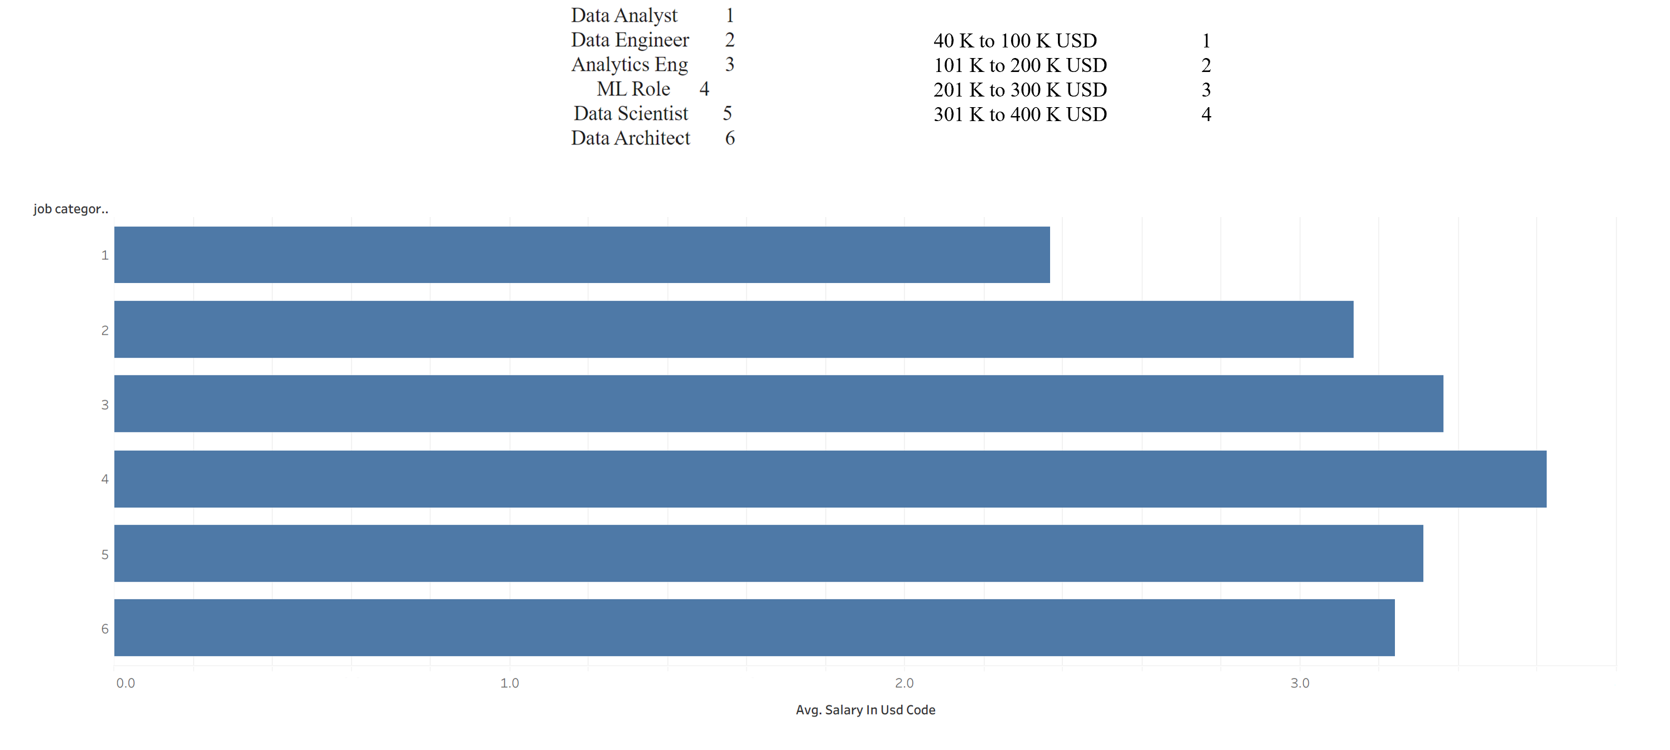
Data Analysis - Model
Average Salary per job title - model
Experience Level frequency per Job Category
June 11, 2023
Data-Related Jobs Salary Predictor app
16

Slide 17
Data Predictions
With PowerPoint, you can create presentations and share your work with others, wherever they are. Type the text you want here to get started. You can also add images, art, and videos on this template. Save to OneDrive and access your presentations from your computer, tablet, or phone.
June 11, 2023
Data-Related Jobs Salary Predictor app
17

Slide 18
Content 2
Subtitle
subtitle
subtitle
Add text, images, art, and videos.
Add transitions, animations, and motion.
Save to OneDrive, to get to your presentations from your computer, tablet, or phone.
Open the Design Ideas pane for instant slide makeovers.
When we have design ideas, we’ll show them to you right there.
Add text, images, art, and videos.
Add transitions, animations, and motion.
Save to OneDrive, to get to your presentations from your computer, tablet, or phone.
Open the Design Ideas pane for instant slide makeovers.
When we have design ideas, we’ll show them to you right there.
Add text, images, art, and videos.
Add transitions, animations, and motion.
Save to OneDrive, to get to your presentations from your computer, tablet, or phone.
Open the Design Ideas pane for instant slide makeovers.
When we have design ideas, we’ll show them to you right there.
June 11, 2023
Data-Related Jobs Salary Predictor app
18

Slide 19
Summary
With PowerPoint, you can create presentations and share your work with others, wherever they are. Type the text you want here to get started. You can also add images, art, and videos on this template. Save to OneDrive and access your presentations from your computer, tablet, or phone.
June 11, 2023
Data-Related Jobs Salary Predictor app
19

Slide 20
Lessons Learned
A few lessons learned here
And here
Refine scope of our questions based on time constraints. Model built to predict salary based on inputs. We did not complete the additional models to predict job title or experience level based on salary.
June 11, 2023
Data-Related Jobs Salary Predictor app
20

Slide 21

Ready to negotiate salary for your new data science position… this app is here to help. Know your worth. You are your best advocate.
June 11, 2023
Data-Related Jobs Salary Predictor app
21

Slide 22
Data Sources
Original dataset: https://www.kaggle.com/datasets/arnabchaki/data-science-salaries-2023,
June 11, 2023
Data-Related Jobs Salary Predictor app
22

Slide 23


Thank You
Presenter name
Email address
Github address
June 11, 2023
Data-Related Jobs Salary Predictor app
23

